Slide 1

CMR COLLEGE OF ENGINEERING & TECHNOLOGY
Kandlakoya, Medchal, Hyderabad - 501401
Department of Computer Science and Engineering
BLOGS:GUIDING THE WAY FOR FUTURE
Batch No.:85
Name of the student:
20H51A0523-T.SAI VENKAT
20H51A05D6-B.GANESH
20H51A05C6-K.RAJA SIMHA REDDY
Under esteemed guidance of
Guide Name
Ms.B.Gayathri
(Assistant Professor)
Batch: 2020-2024

Slide 2
Outline
Abstract
Introduction
Research Objective
Problem Definition
Scope of the Project
Literature Review
Implementation of Existing system
Proposed Method
Block Diagram
System Architecture
Conclusion
References
Notes:
2

Slide 3
Abstract
Notes:
3

Slide 4
ABSTRACT
Join us on a fascinating exploration of the world of coding, mind-bending puzzles, thought-provoking topics, real-life experiences, and invaluable interview insights. Whether you're a seasoned developer, a puzzle enthusiast, or simply curious about diverse perspectives, our blog has something for everyone. Learn from the shared experiences and feedback of our contributors, who share their unique journeys in the tech world. Dive into coding conundrums, tackle brain-teasing puzzles, and gain valuable insights from interview experiences. We're here to inform, entertain, and inspire – come be a part of our community!
In this abstract, the title encompasses the core themes of coding, puzzles, topics, experiences, feedback, and interview experiences. The abstract teases the content by hinting at the diverse range of information available in the blog and encourages readers to engage with the content. It's both informative and inviting, encouraging potential readers to explore the blog in more detail

Slide 5
INTRODUCTION
Notes:
5

Slide 6
Introduction
In the digital age, blogging has emerged as a powerful medium for sharing knowledge, insights, and personal experiences with a global audience. As the blogosphere continues to expand, there is an increasing need for efficient and user-friendly blog management systems that cater to the diverse interests and requirements of users. This project introduces a sophisticated web-based blog management platform that aims to revolutionize the way blogs are created, accessed, and administered.
Notes:
6

Slide 7
Research Objective
Notes:
7

Slide 8
Research objective
The research objective of our project is to empower learners in diverse domains and on various platforms by imparting both knowledge and confidence, offering practical experiences, soliciting and sharing feedback, and equipping them with strategies to overcome challenges effectively.

Slide 9
Problem Definition
Notes:
9

Slide 10
Problem Definition
The problem our project aims to address is the significant barrier that beginners face when trying to acquire knowledge and confidence in various domains and platforms. Many learners encounter challenges, including a lack of guidance, difficulties in navigating complex topics, and limited support for overcoming obstacles. This project seeks to mitigate these issues by providing comprehensive resources, experiences, feedback, and strategies to foster effective learning and confidence building.

Slide 11
Scope of the Project
Notes:
11

Slide 12
.
.
Scope of the Project
The scope of the project involves a comprehensive and learner-centric approach to address the challenges faced by beginners in acquiring knowledge and confidence in various domains and on different platforms. It includes:
Educational Resources: Developing a wide range of educational content, tutorials, and guides to cover diverse domains and platforms, ensuring they are beginner-friendly and easily accessible.
Practical Experiences: Providing practical experiences, hands-on exercises, and interactive learning tools to enhance the understanding and application of concepts.

Slide 13
Literature Review
Notes:
13

Slide 14
Comparision table for the Existing System
S.No | Authors and Journal Name& Year of publication | Problem Statement | Name of the Pr oposed solution/Method | Solution | Remarks
1 | Jill Walker Rettberg | In an age of information abundance and digital communication, there exists a pressing need to address the challenges and issues associated with the creation, dissemination, and consumption of blog content. | BlogAdvocate: Empowering Learners and Enhancing Blog Communities. | Content Quality and Credibility Enhancement. Information Overload Management. | Implementing tools for content verification and citation can significantly enhance the trustworthiness of blog content.
2 | Romal Thoppilan, Daniel De Freitas, Jamie Hall, Noam Shazeer, Apoorv Kulshreshtha Google 10 Feb 2022 | LLM’s can perform in output not as suitable as it is required to be and may face difficulties in efficiency of giving the information. | LaMDA: Language Models for Dialog Applications | To compare the per-application helpfulness (i.e., useful and correct responses) and role consistency of pre-training-only (PT) and LaMDA models when subject to the same application-specific preconditioning. | LaMDA is conversationally proficient but less specialized for engineering. A domain-specific GPT offers precision and engineering expertise. Choice depends on the context, with LaMDA suitable for general conversations and GPT for technical engineering queries.

Slide 15
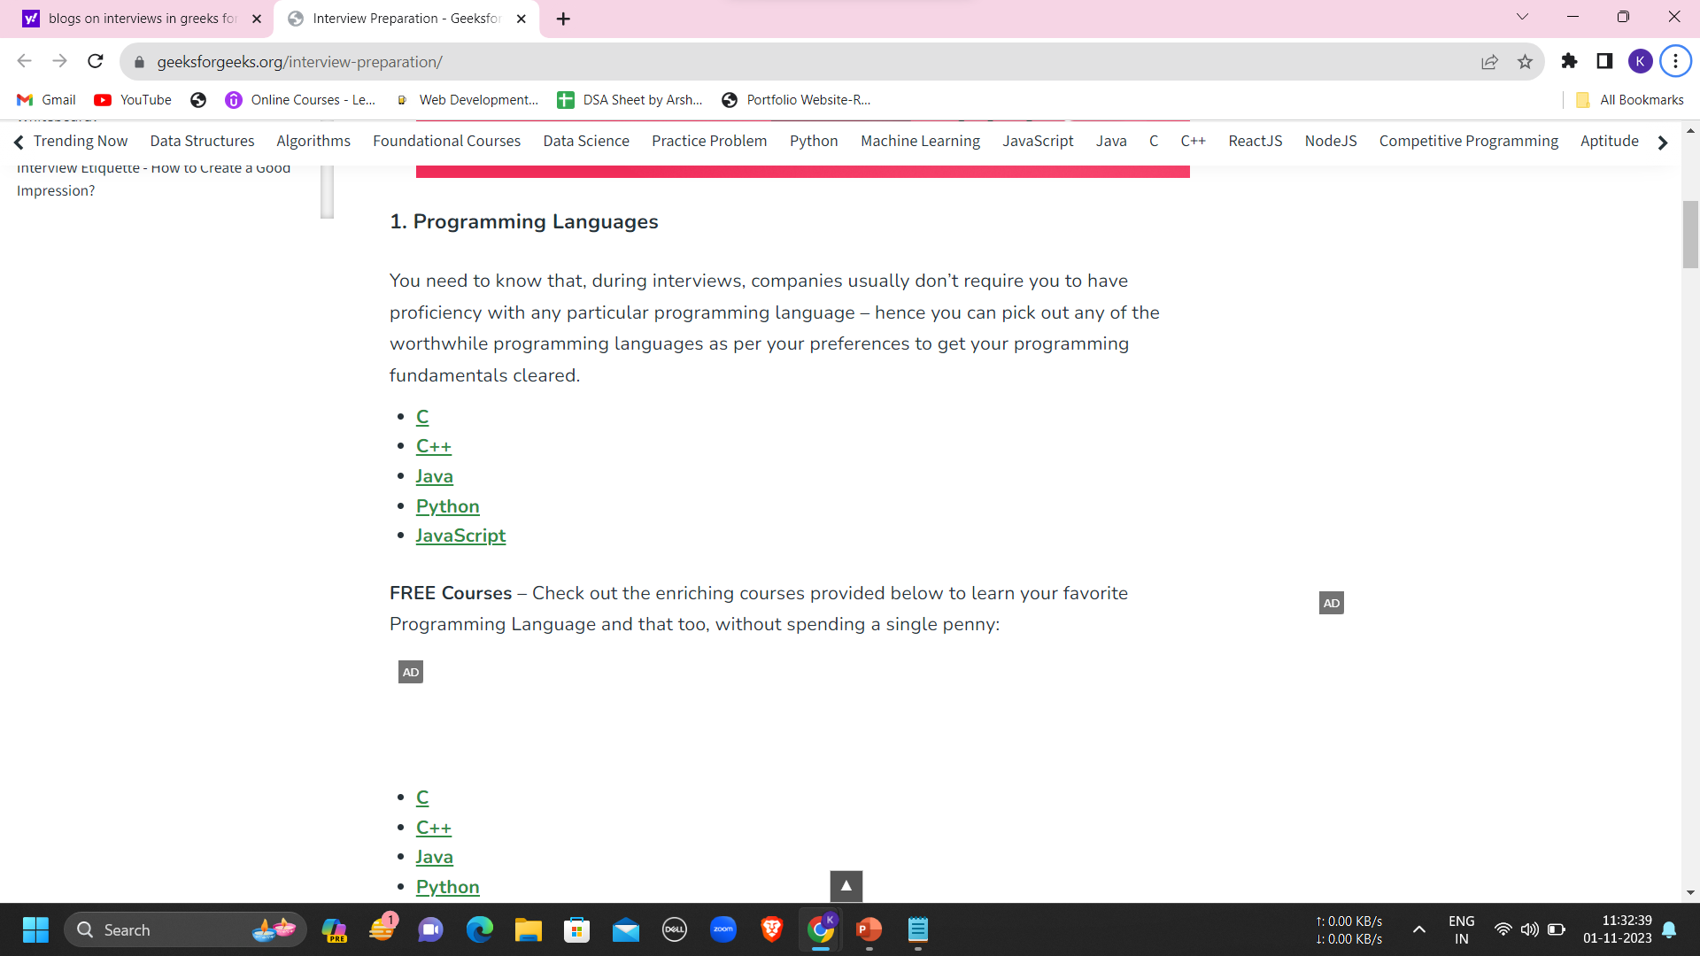
Implementation of Existing System
1.Greeks for greeks:

Slide 16
PROPOSED SOLUTION
Notes:
16

Slide 17
PROPOSED SOLUTION
NAME:BLOGS
The proposed solution is a blog platform designed to provide students with comprehensive insights into hackathons and interviews. This platform aims to be an informative and engaging resource for students looking to enhance their skills, prepare for challenges, and succeed in the competitive world of technology and job interviews.
In this platform students login to the platform through login credentials given to them.
It also consist of categorical search such as
1.Search via companies.
2.Interview questions.
3.Competitive coding discussions.
4.Feedbacks and suggestions
5.Experiences.

Slide 18
PROPOSED SOLUTION
It consist of
1. Hackathon Insights:
Event Listings:A curated list of upcoming hackathons worldwide, providing details such as date, theme, and registration links.
2. Interview Chronicles:
Interview Experiences:Real-life accounts of tech interviews from various companies, showcasing different interview formats, questions, and challenges.
3. Skill Building Resources:
Tutorials and Guides: Step-by-step tutorials on coding languages, algorithms, and other technical skills essential for hackathons and interviews.
4.Challenges and Experience:
It consist of experience of various challenges participated by Senoirs
Blogs aims to empower students with the knowledge, skills, and confidence needed to excel in hackathons and interviews, fostering a community that supports continuous learning and professional growth in the tech industry.
This proposed solution envisions a comprehensive and interactive platform to bridge the gap between classroom learning and real-world success for students pursuing careers in technology.

Slide 19
BLOCK DIAGRAM
Notes:
19

Slide 20
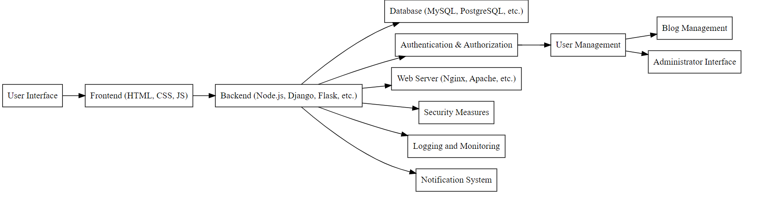
BLOCK DIAGRAM

Slide 21
SYSTEM ARCHITECTURE
Notes:
21

Slide 22
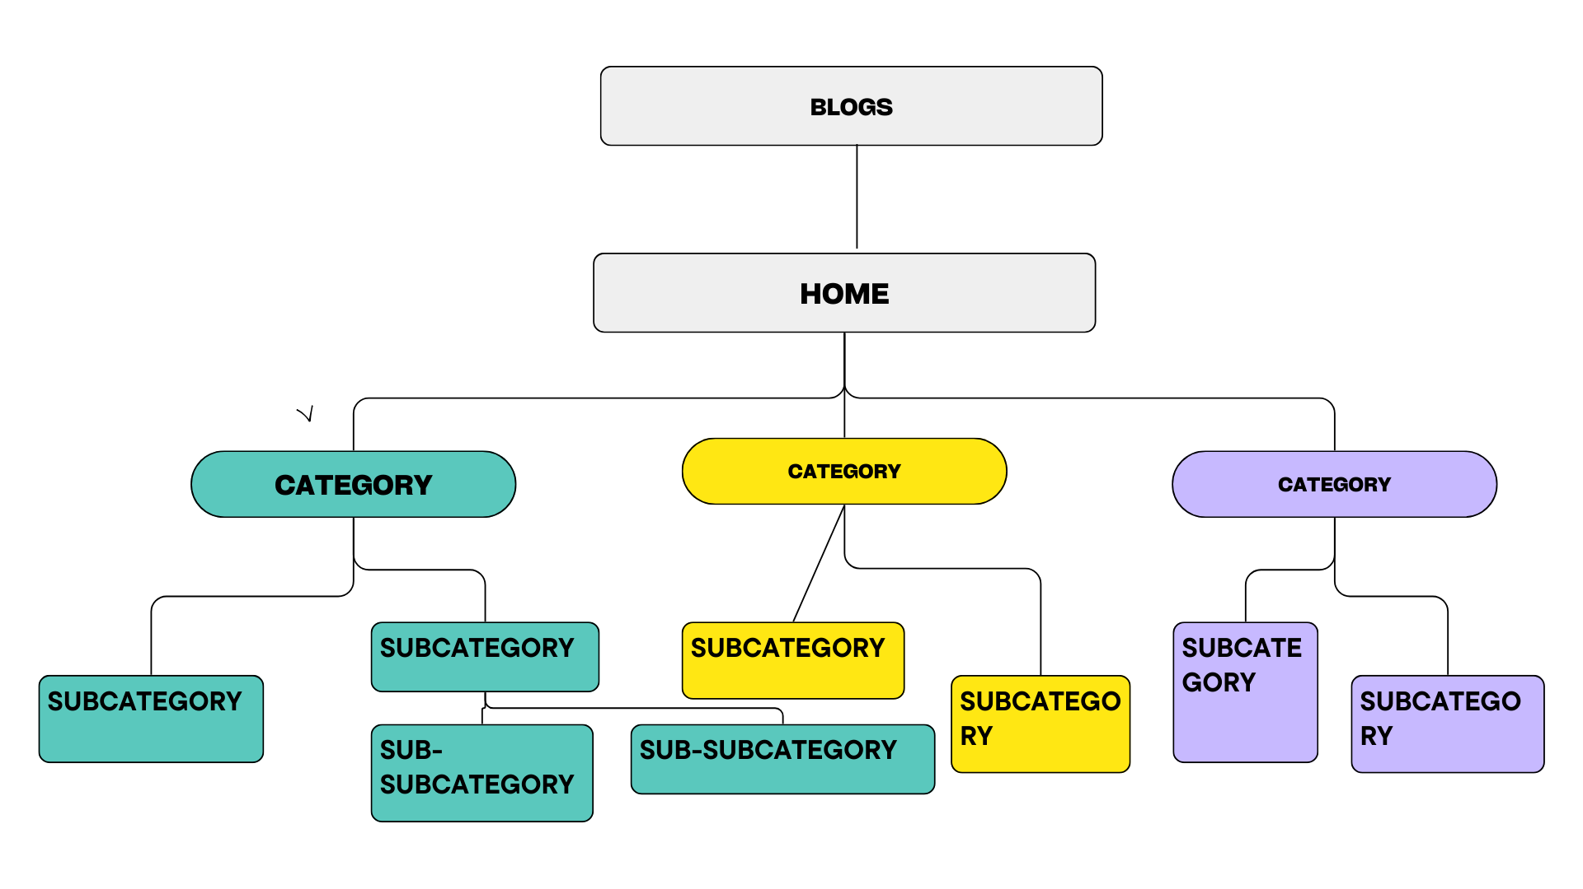
SYSTEM ARCHITECTURE

Slide 23
Result
Results from engaging with blogs for beginners include the opportunity to acquire valuable knowledge in a specific domain, discover reliable platforms for learning, become a part of thriving communities, and gain a clear path towards achieving their desired goals.

Slide 24
Conclusion
Blogs have become a significant and influential medium of communication and information sharing in the digital age. Here's a conclusion about blogs, highlighting their impact and significance:
Accessible Platform for Information Sharing.
Diverse Content and Niche Communities.
Educational Resource.
Challenges and Concerns.

Slide 25
References
1.Websites.
2.Articles.
1. Django Documentation: Official documentation for the Django web framework. It provides detailed information on how to use Django for web development: https://docs.adjangoproject.com/
2. HTML and CSS Documentation: W3Schools provides comprehensive tutorials and references for HTML and CSS, including examples and explanations: https://www.w3schools.com/html/ and https://www.w3schools.com/css/
3. JavaScript Documentation: Mozilla Developer Network (MDN) offers extensive documentation, guides, and examples for JavaScript: https://developer.mozilla.org/en-US/docs/Web/JavaScript/Guide

Slide 26
Thank You!

